Slide 1
Level 6 Group 5
Jay Pointer, Dalton Kirk and Ashley Burton

Slide 2
Log Line- A globally competitive snack game with tactically immersion.
Demographic- 18-24 Males
Goal-

Slide 3
Mechanics

Slide 4
Player Experience and Fun
Hard Fun
Links into Fierro
Player
Player Experience

Slide 5
Ideal First 10 Minutes

Slide 6
Immersion
Tactical Immersion
In game where the skill required to complete a level brings a player into the game
Could be phrased as “In the Zone”

Slide 7
Tension and Release
Tension through each level
Increase overtime.
Keeping the player engaged.
Release once level is completed.
Release and Reward throughout the game
Rewards come with release.
Reward player with help on mechanics and score.
Repeating difficulty curve to keep the game interesting but accessible to players of all skill levels.
Learn, practice, master loop.
New mechanic
Hard
Tension
Time
Easy
Levels

Slide 8
Mobile Accessibility
UI
Size of everything on the screen
Art Style
Input
Short Levels

Slide 9


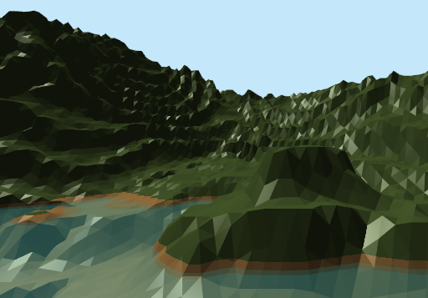
Art Style
Low poly 3d Art Style
Pastel Colours

Slide 10
Questions?

